Slide 1
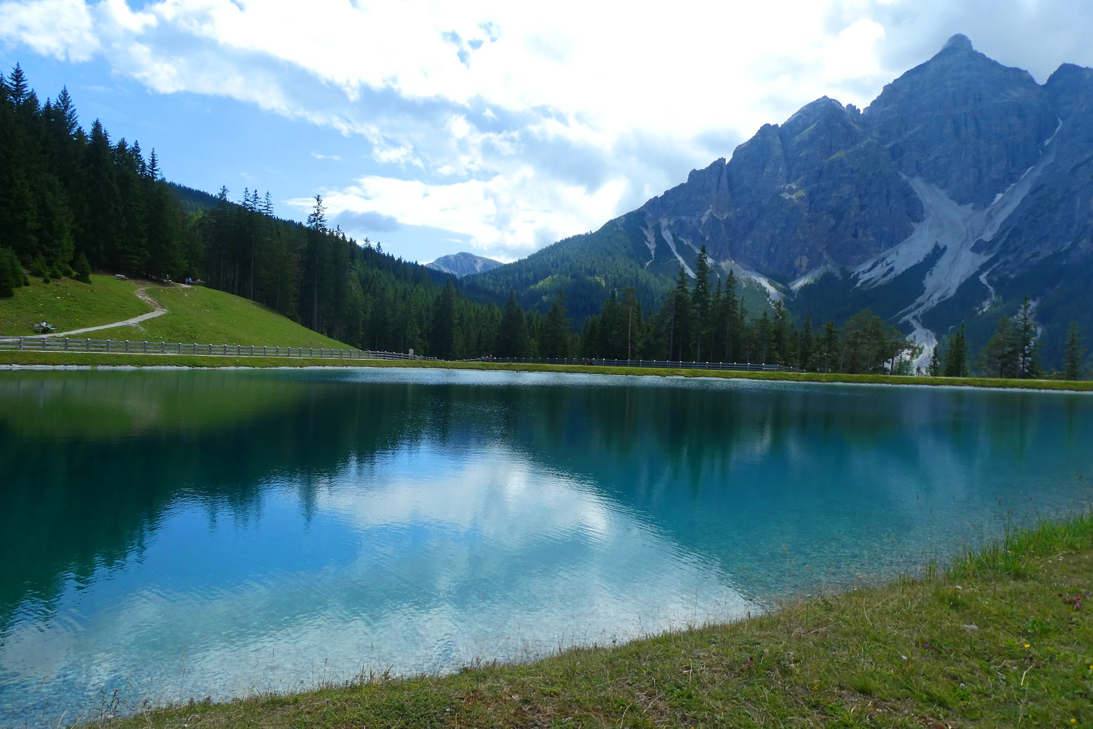
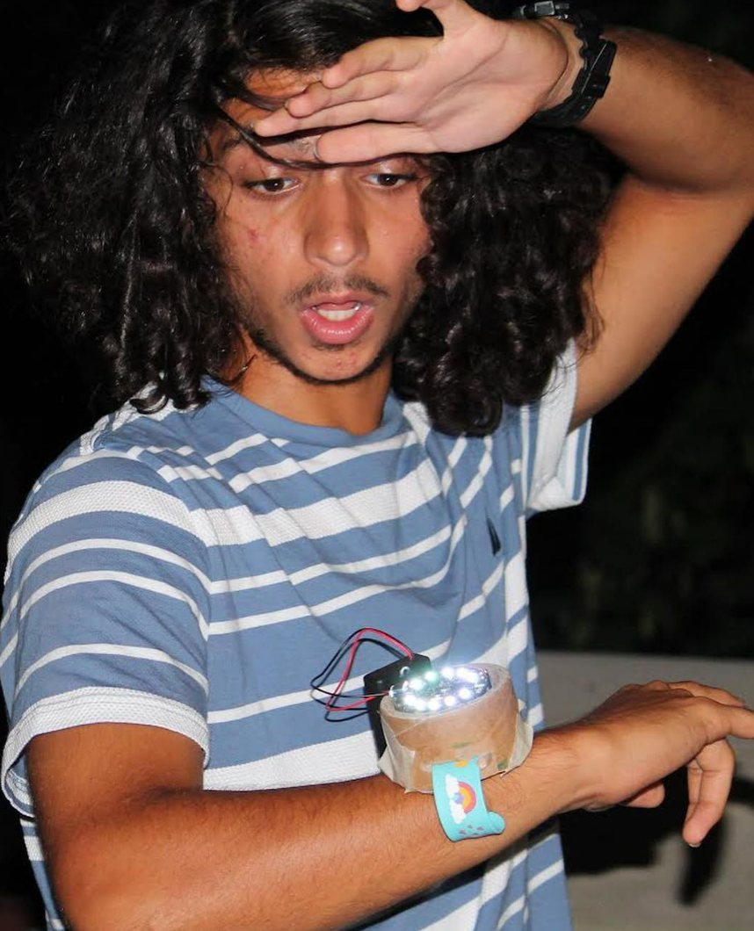
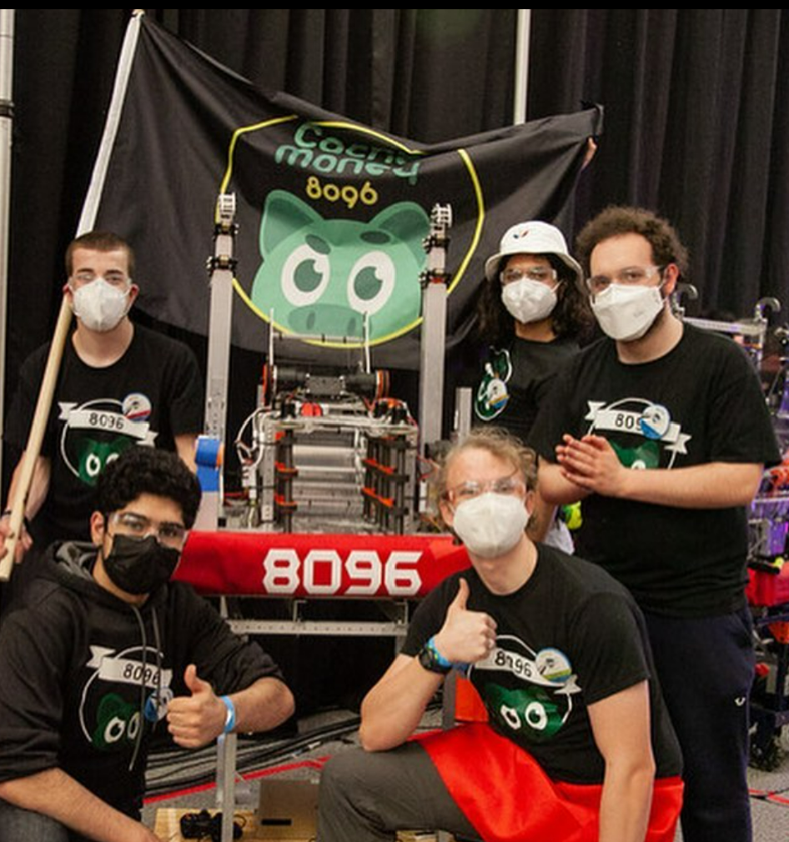
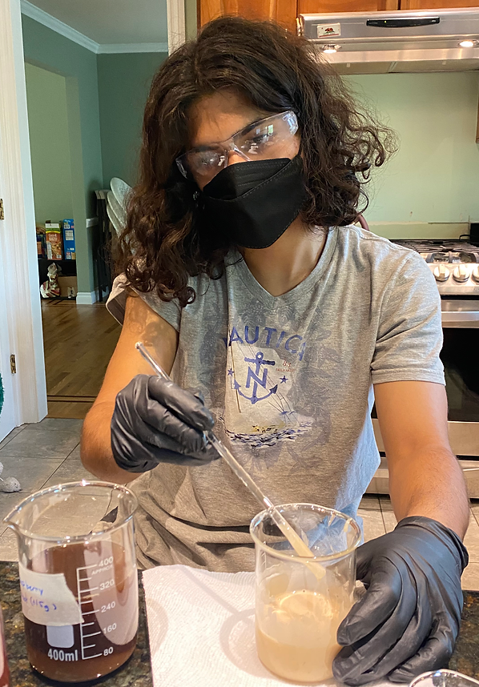
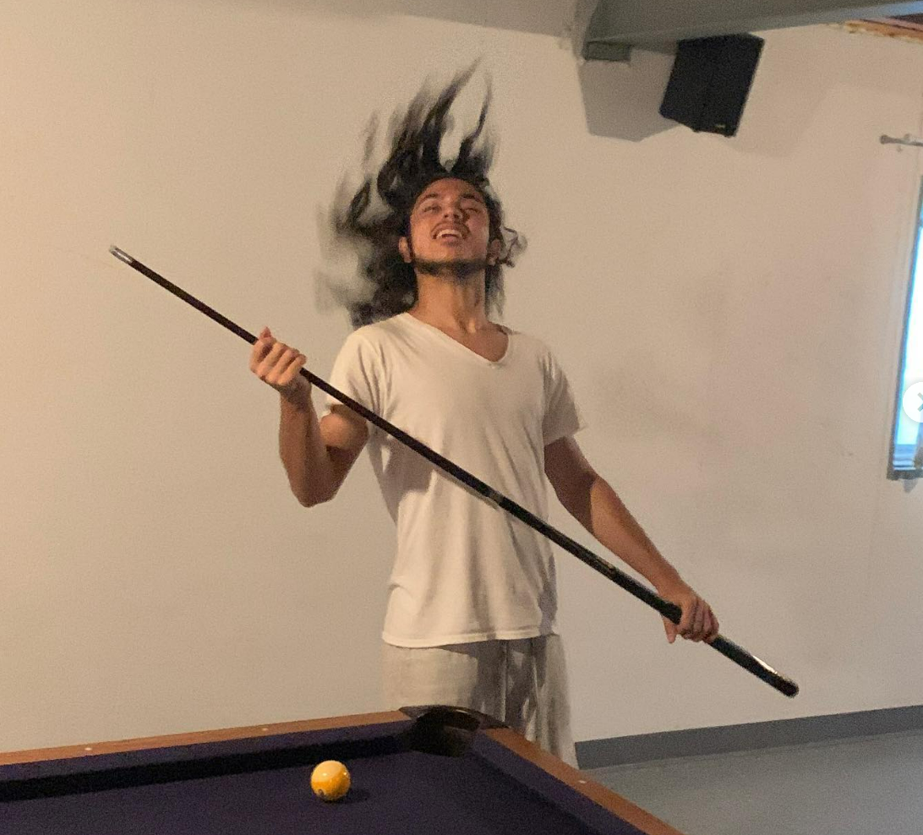
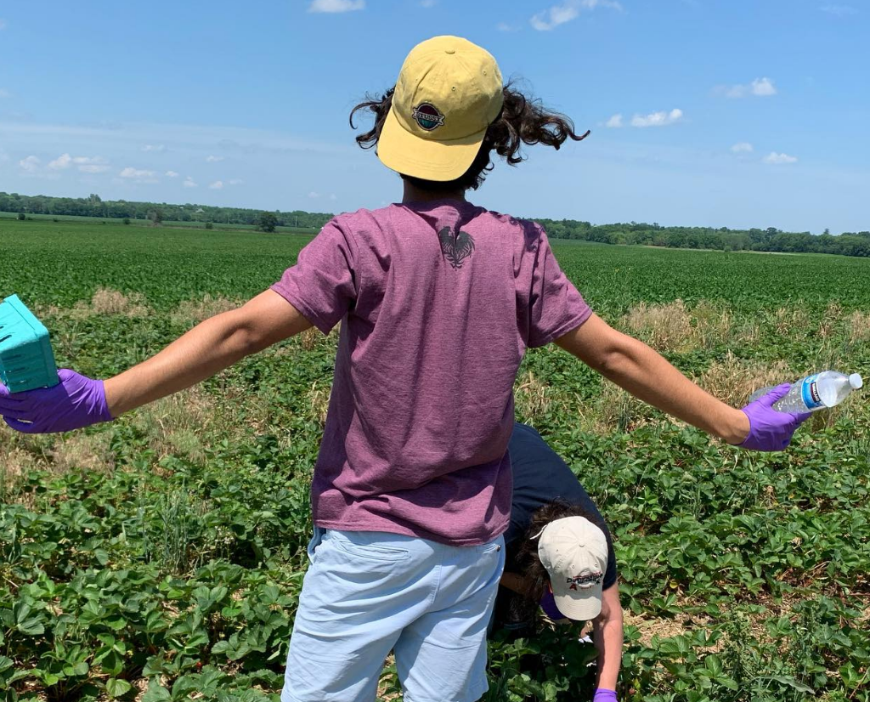
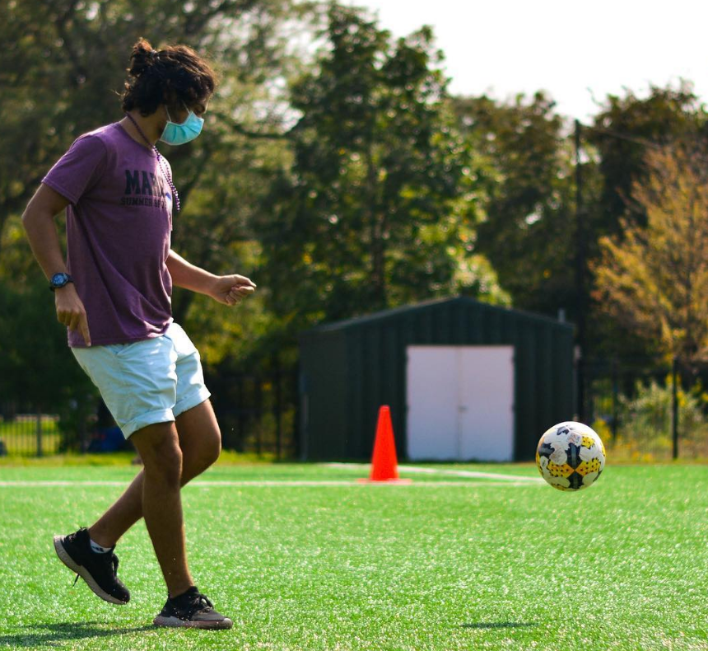
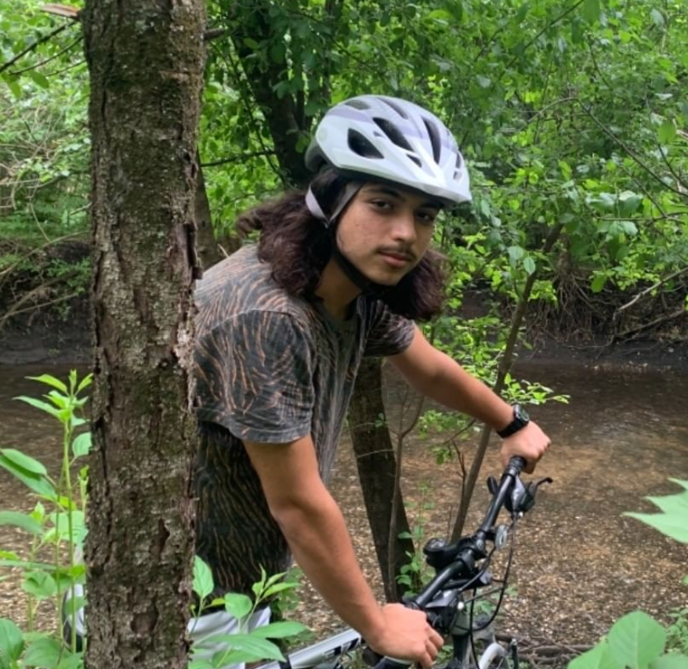
Fun Fact: I am is the shortest sentence in the English language.
I’m Alp!

Slide 2
Current Progress
Next Steps
High-level Familiarity with Workflow at Bio and RPL Workcell
Training Modules & Delving Deeper into Programming Module
Goals:
Have a lot of fun!
Achieve an Integrated Workflow System in Bio Workcell
Learn about SDL Interface Mechanisms + Various Projects in RPL and Bio Departments
Contribute to Publishing a Paper Based on Findings

